Slide 1

BE Development #2 Microservices
Otniel Yosi Viktorisa
Product Developer Team Lead at PT. Altrovis Tekno Global
otniel.y.viktorisa@gmail.com

Slide 2
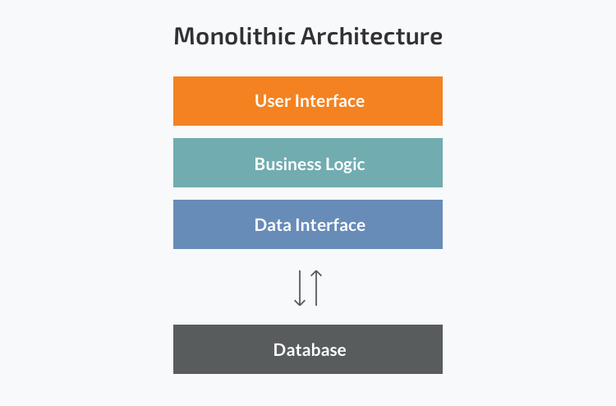
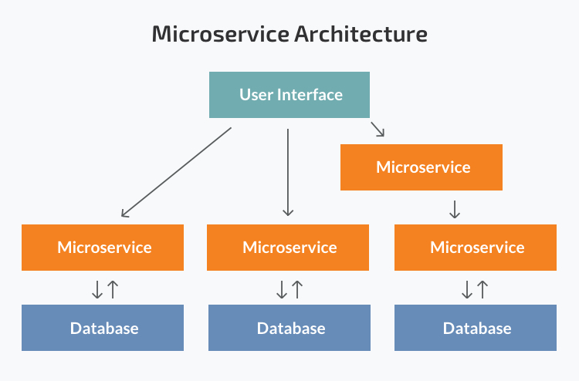
Monolith vs Microservice
Images:https://www.n-ix.com/microservices-vs-monolith-which-architecture-best-choice-your-business/

Slide 3
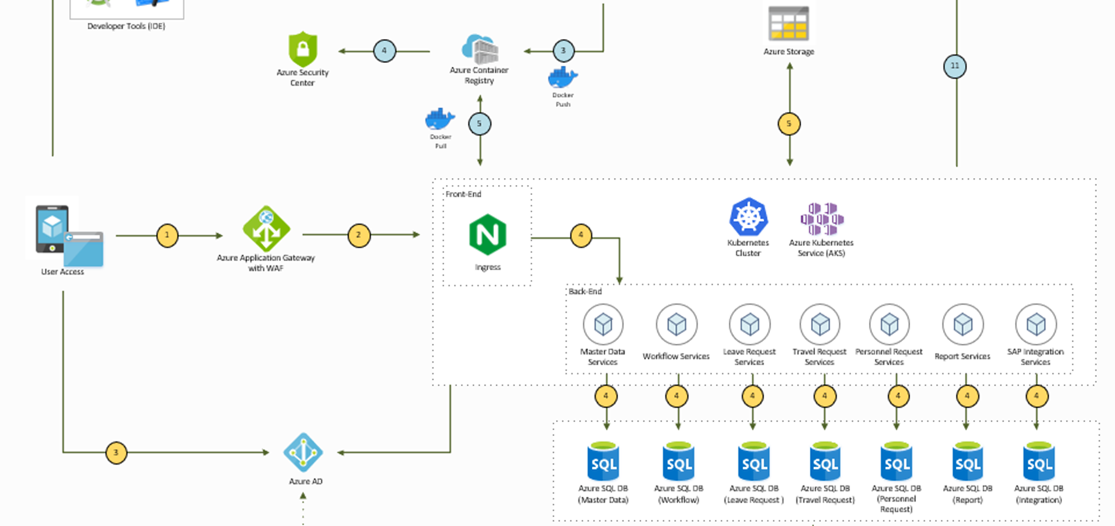

Slide 4
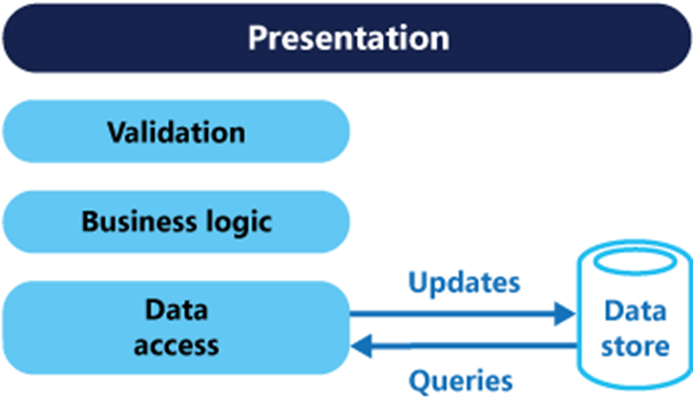
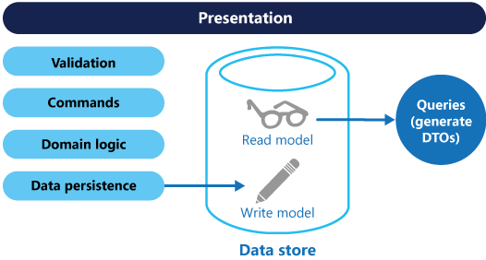
CQRS Pattern
Command and Query Responsibility Segregation
Mainly used in microservices
Images:https://docs.microsoft.com/en-us/azure/architecture/patterns/cqrs

